Slide 1
UART with Chat Box implementation
Course: ECE 176
Professor: Dr. Stillmaker
By: Josh Lopez
Zach O’Neil
Omer Al Sumeri

Slide 2
Table of contents
01
02
03
04
Introduction
Design
Implementation & Demonstration
Learning Points/Conclusion
Notes:
Josh

Slide 3
1.Introduction
Notes:
Josh

Slide 4
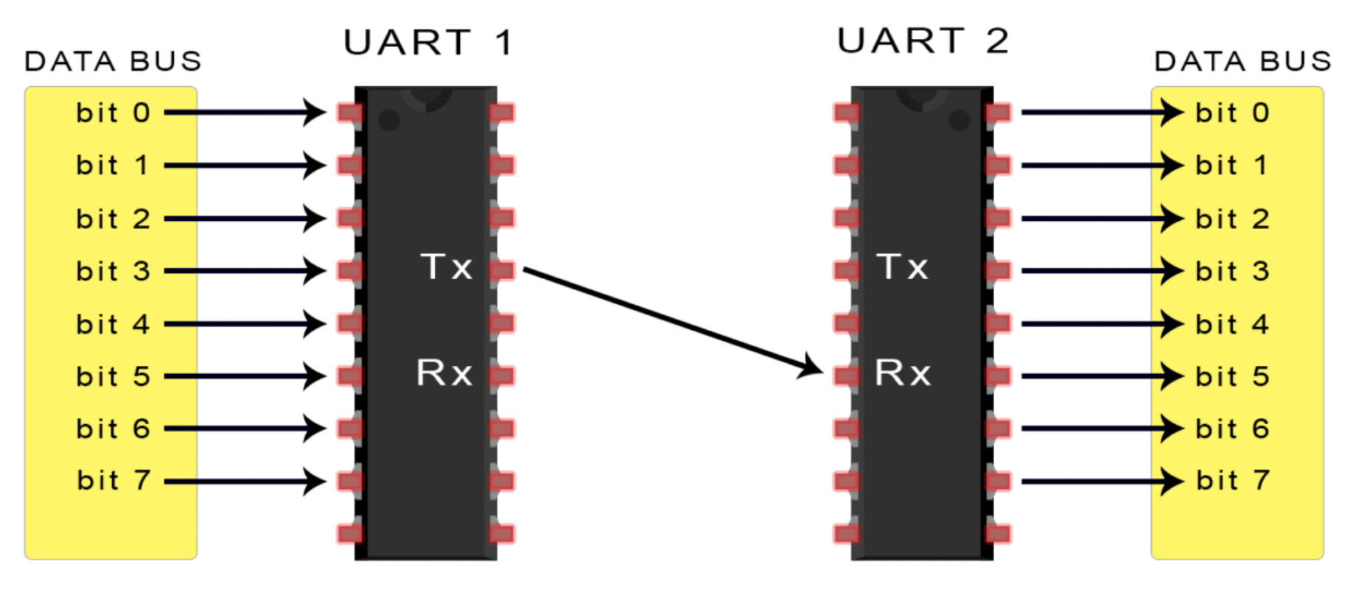
Introduction
UART stands for Universal Asynchronous Receiver/Transmitter
Serial communication
Asynchronous
Baud Rate, Ex: 115200
Full Duplex
Contains TX(Transmit) and RX(Receive) ports
UART1 receives 8 bits in parallel
TX of UART1 sends 1 bit at a time to the RX of UART2
After UART2 receives 8 bits serially, the byte has been successfully transmitted
Notes:
Josh

Slide 5
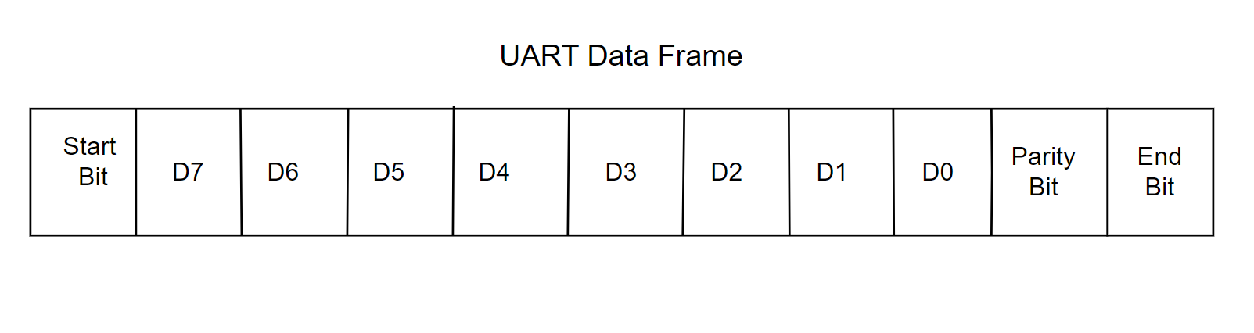
Additional Background
UART Data Frames are not always the same
UART Data Frame implemented is as follows:
Start bit is always 0
Byte of data will then follow with the MSB transmitted first
Odd parity bit
If odd number of 1’s in byte of data, parity bit is 0
If even number of 1’s in byte of data, parity bit is 1
End bit is always 1
Notes:
Josh

Slide 6
Goals of Project
Demonstrate full duplex UART communication with an application of a chatbot
Chatbot is capable of sending and receiving a 64 bit (8 byte message)
The message will be loaded into sending UART byte by byte and byte will be transmitted through the UART protocol
Once the chatbot receives the message (8 bytes), the message will be printed onto the terminal using ASCII translation
Notes:
Josh

Slide 7
2.Design
Notes:
Josh

Slide 8
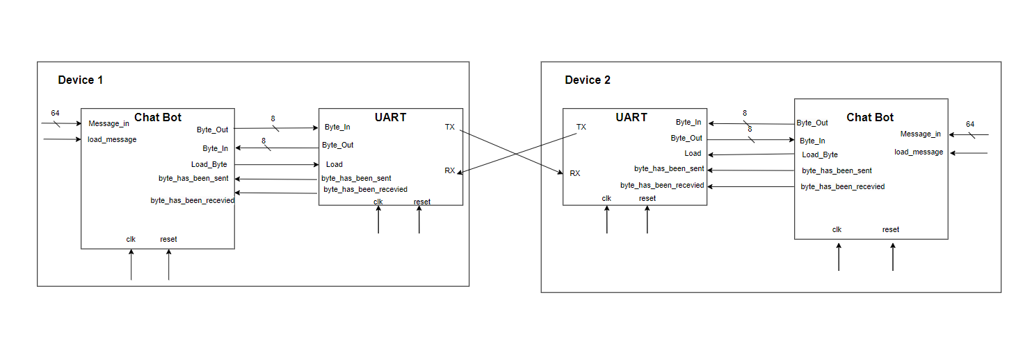
Block Diagram
Notes:
Omar

Slide 9
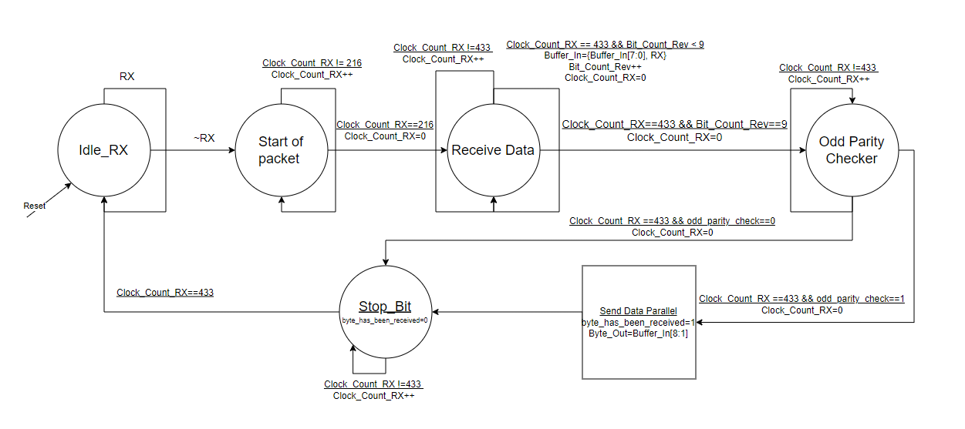
State Machine for UART (Receiving)
Notes:
Zach

Slide 10
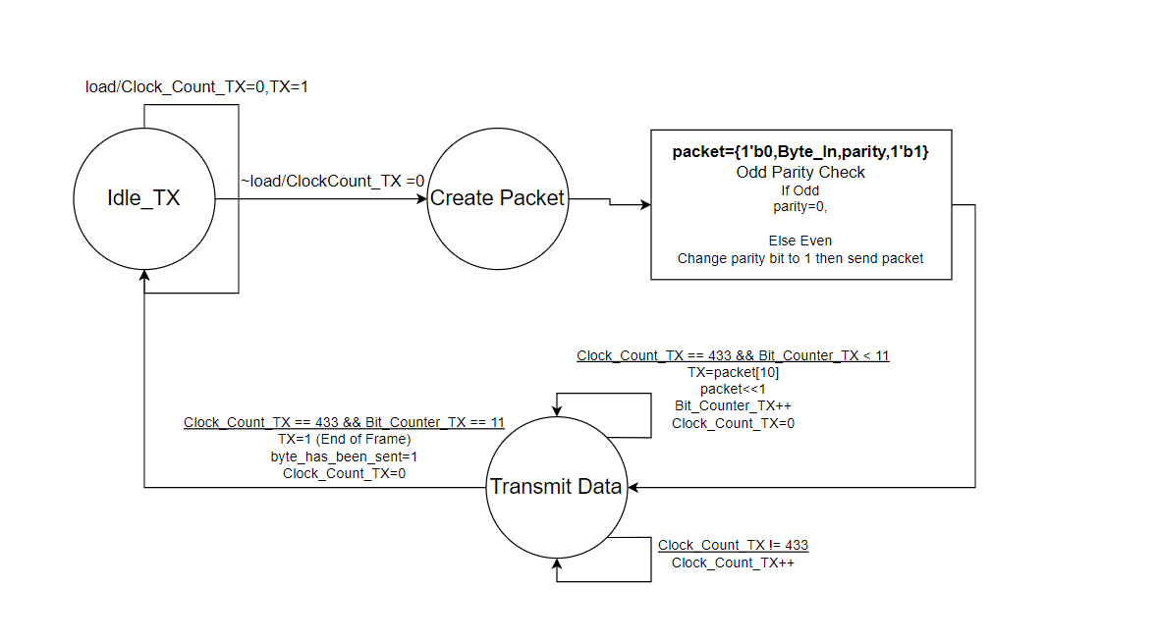
State Machine for UART (Transmitting)
Notes:
Zach

Slide 11
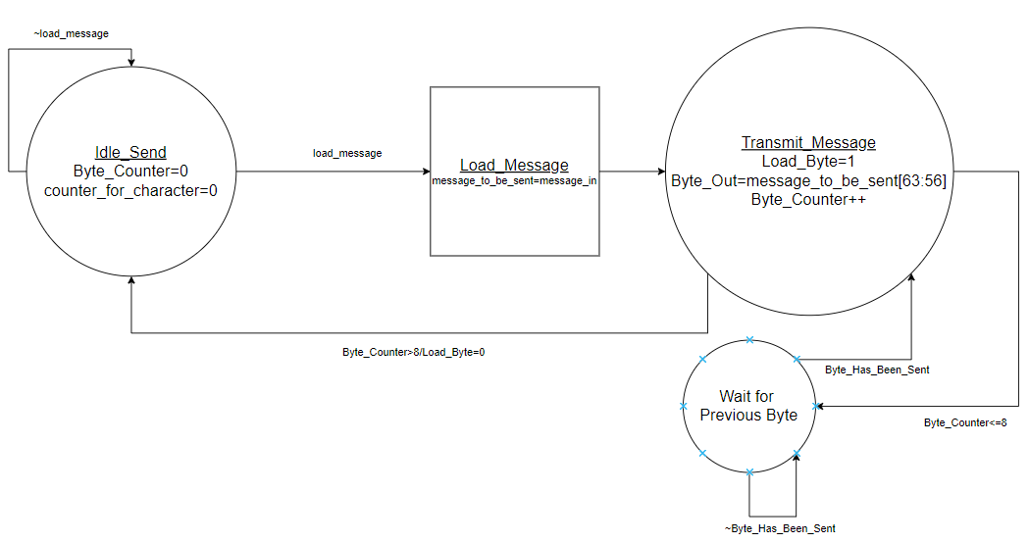
State Machine for Chat Bot (Transmitting)
Notes:
Zach

Slide 12
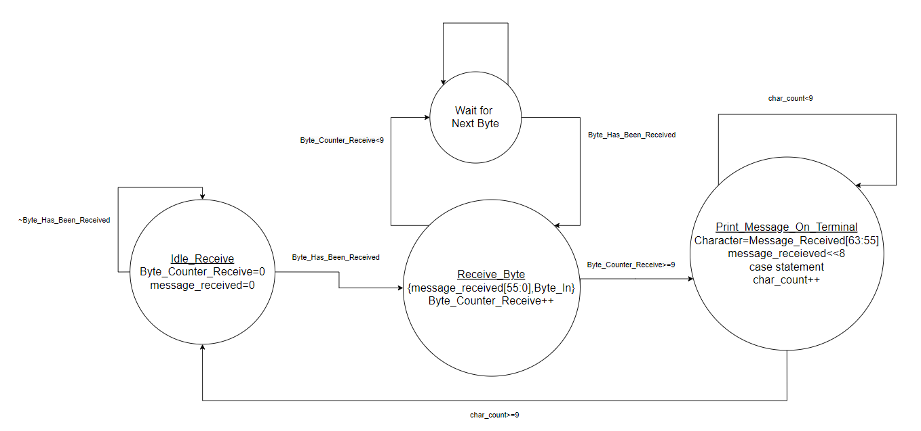
State Machine for Chat Bot (Receiving)
Notes:
Zach

Slide 13
3.Implementation/Demonstration

Slide 14
Implementation
Two modules were created according to our state machines
UART
Chatbot
An always block was created for each state machine
Two tests were done to test the project
Individual Test on the UART module
Test of UART and Chatbot module
Notes:
Josh

Slide 15
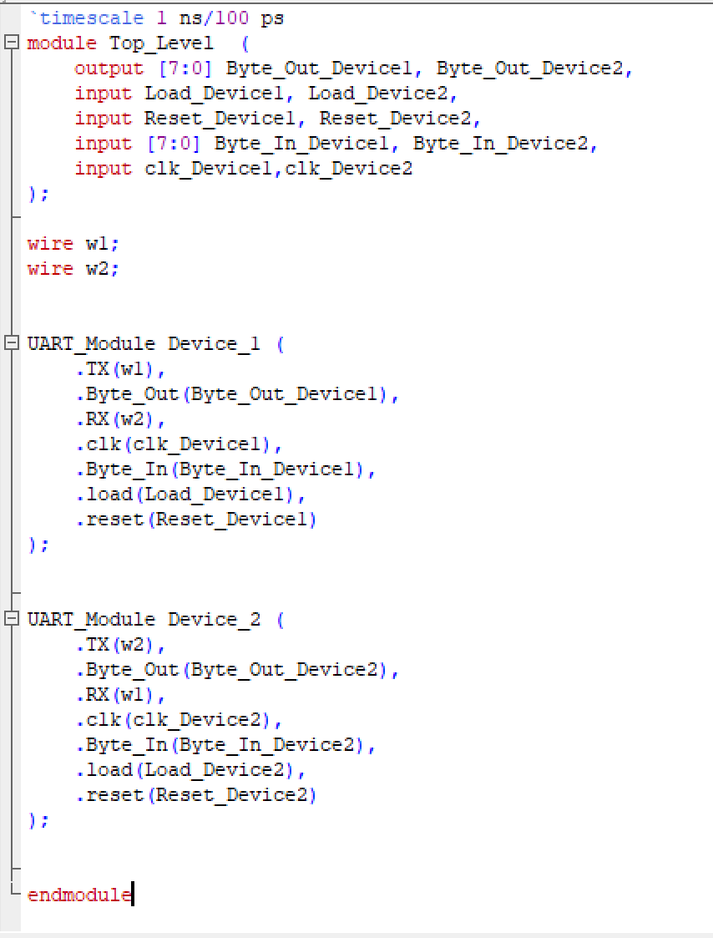
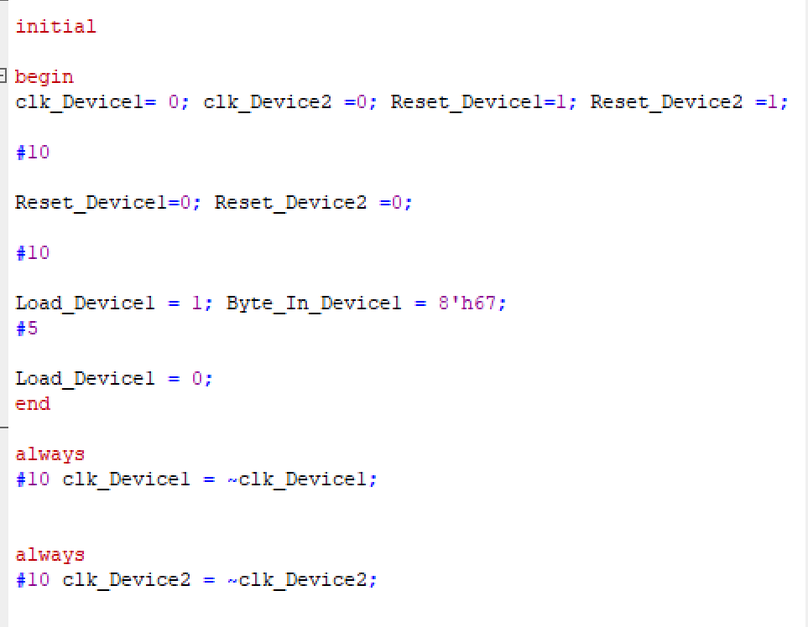
Top Level and TB of UART testing

Slide 16
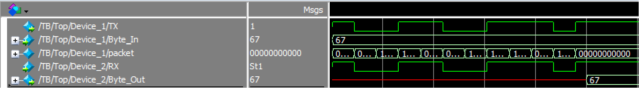
Waveform of individual UART test

Slide 17
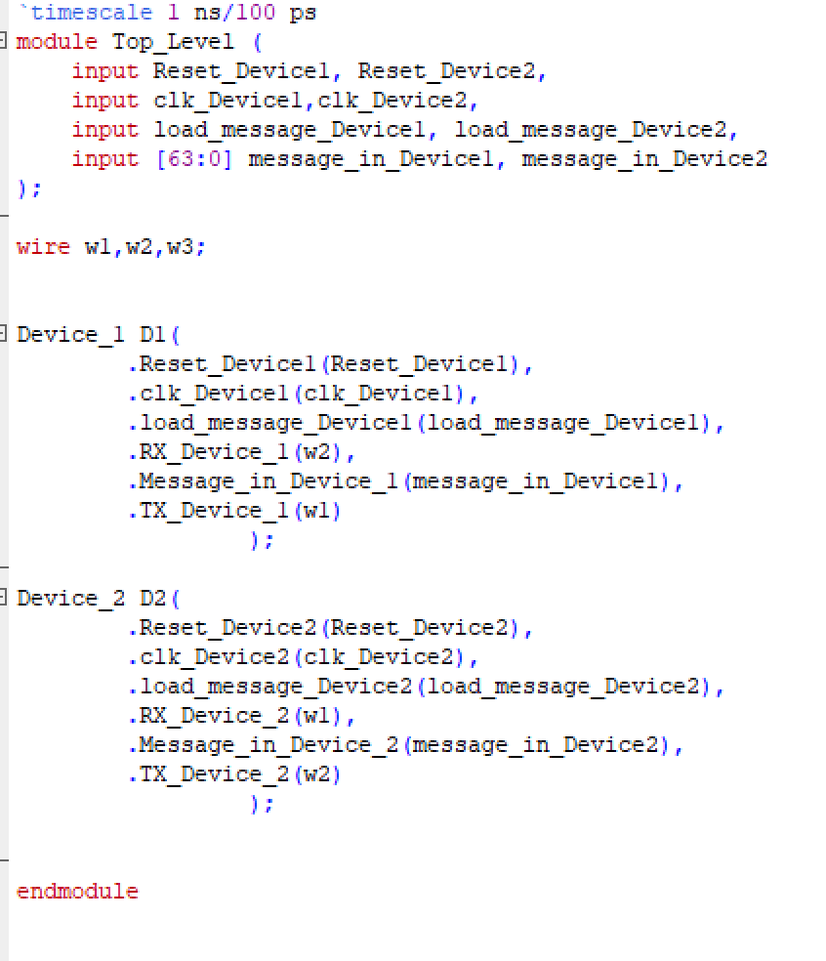
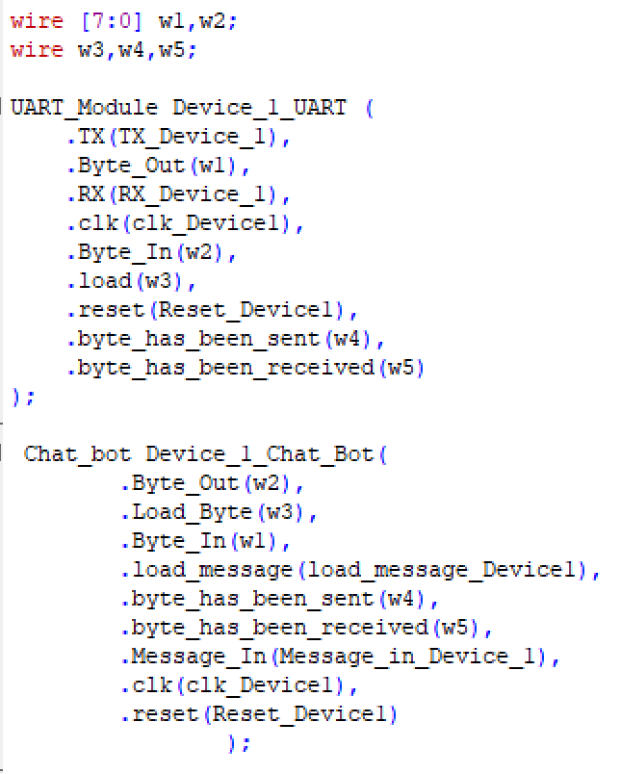
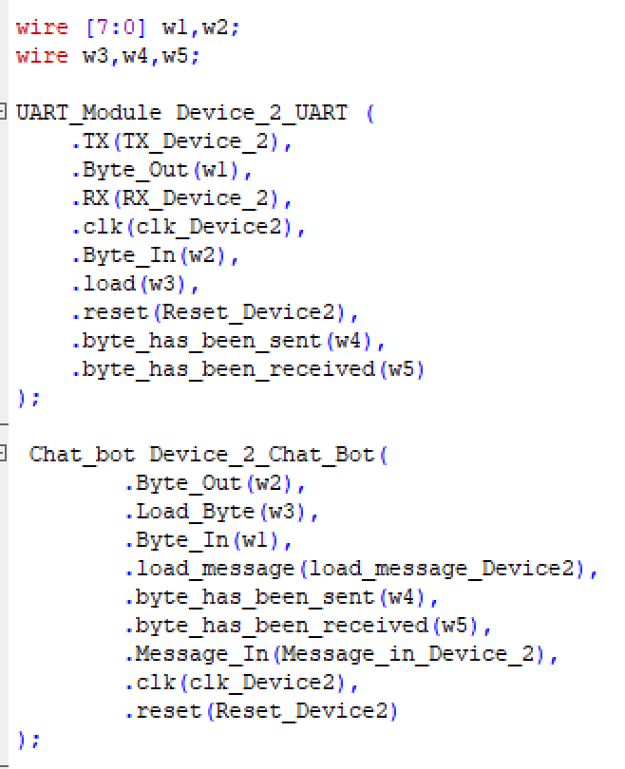
Top Level of Chatbot
Top_Level.v
Device_1.v
Device_2.v

Slide 18
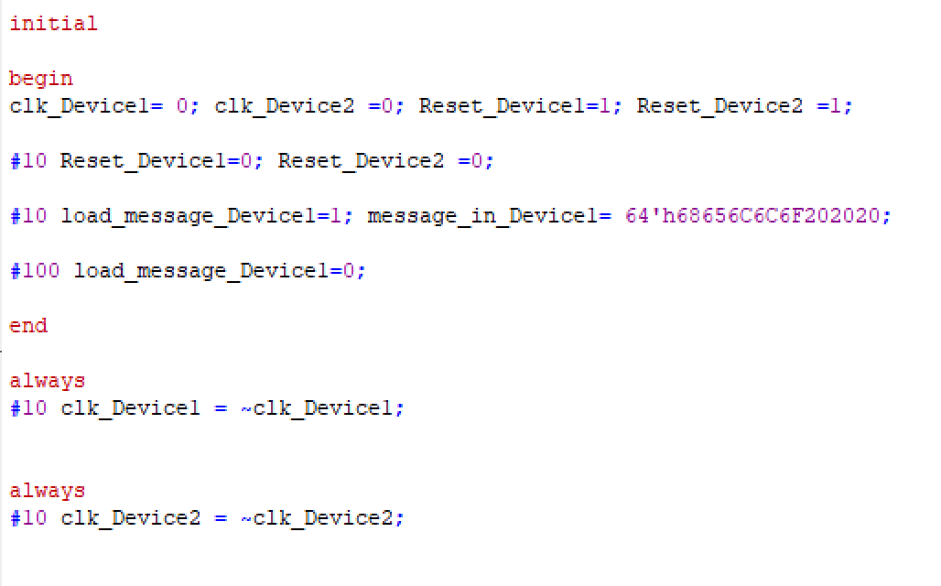
TB of Chatbot
Message being sent is “Hello “

Slide 19
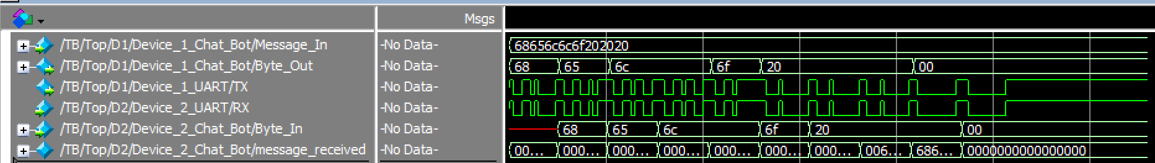
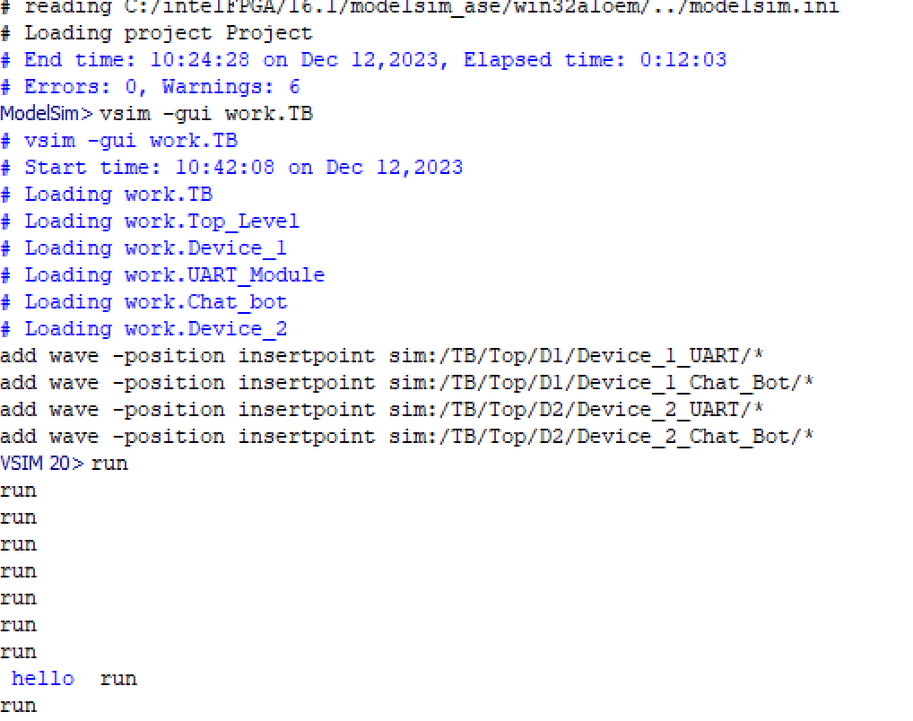
Waveforms of Chatbot
After 960 microseconds the message is printed onto the screen

Slide 20
Learning Points/Conclusion
Through this project we learned:
How to implement asynchronous communication in Verilog
Timing and edge of the clock is important

Slide 21
References
https://www.circuitbasics.com/basics-uart-communication/

Slide 22
Thank you
Questions?

